Slide 1

USE OF DATA STRUCTURES IN BOOKMYSHOW APP
By:-
B. Seshasayee(RA2211031010045)
K. Sanjana(RA2211031010030)
M. Sankar(RA2211031010024)

Slide 2
USE OF DATA STRUCTURES IN BOOKMYSHOW APP
BookMyShow is a popular Indian online ticketing platform and app that allows users to book tickets for a wide range of events, including movies, live performances, sports events, and more. It is one of the largest and most widely used ticketing platforms in India.
Data structures play a crucial role in the functionality and performance of applications like BookMyShow.
They are used to efficiently store, retrieve, and manipulate various types of data, such as user information, event details, booking records, and more. Here are some of the key roles that data structures play in the BookMyShow app:

Slide 3
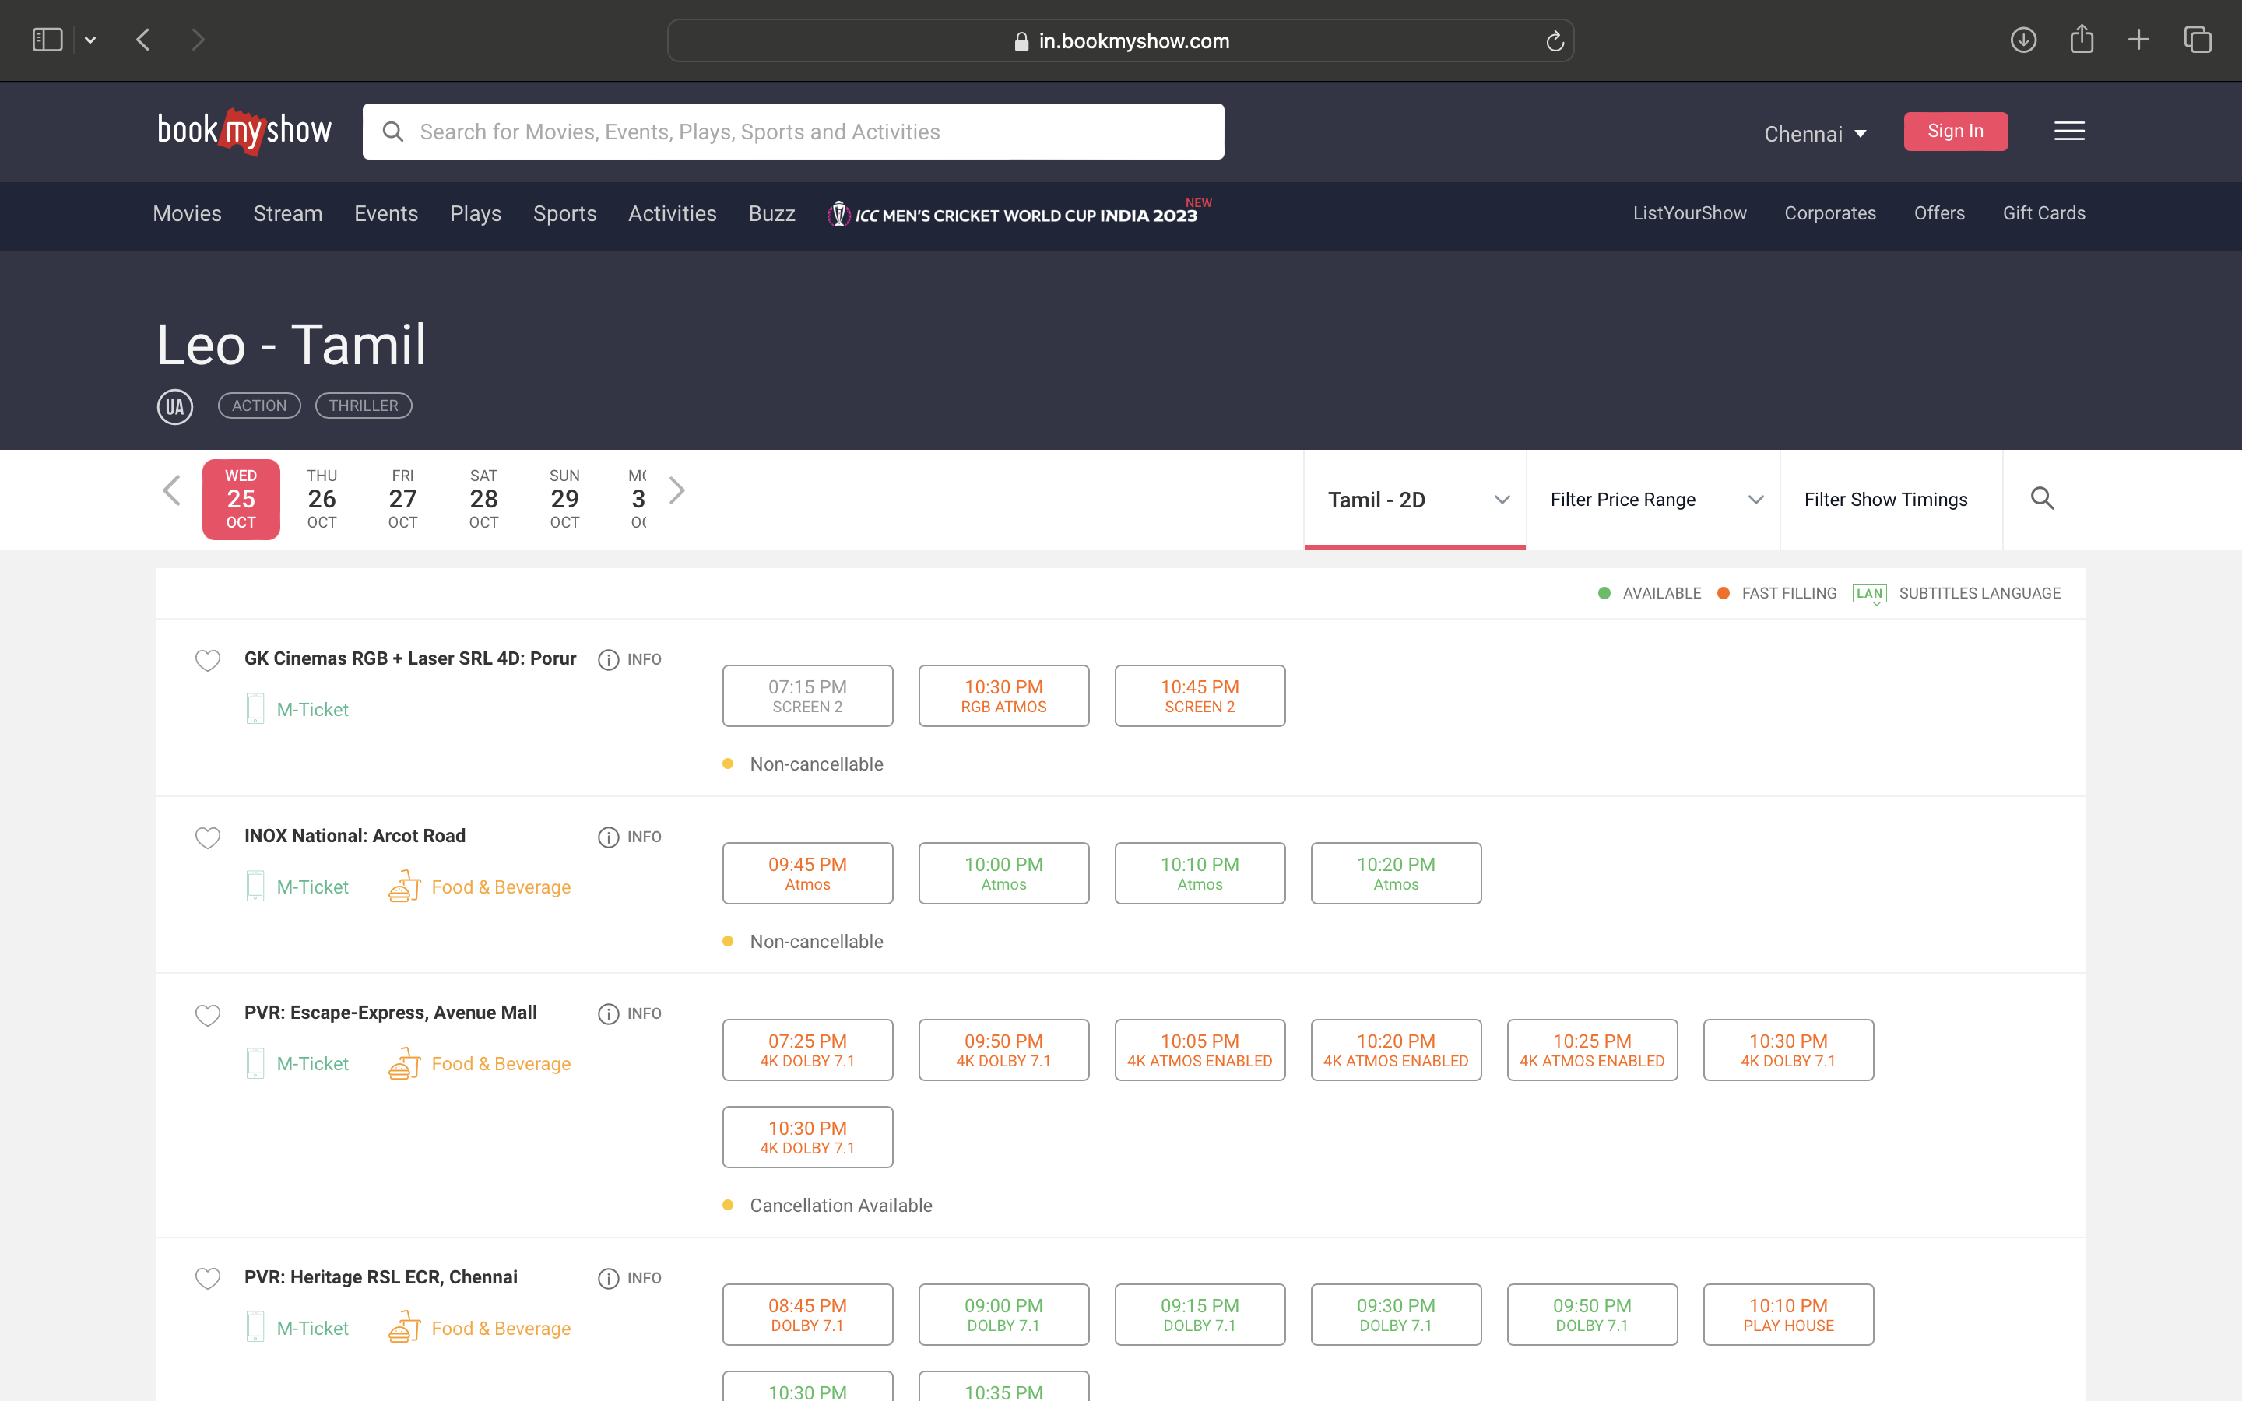
FUNCTIONS
Booking Records: Data structures are used to keep records of user bookings, including the event or movie, the number of tickets, seat numbers, and transaction details. This information is crucial for tracking and verifying bookings.
These data structures can be implemented as databases, linked lists, or arrays, ensuring that user bookings are correctly associated with their accounts.

Slide 4
Event Scheduling: The app needs to maintain schedules for various events, including movie showtimes, concerts, and sports events.
Data structures are used to store event details, including movie showtimes, theater locations, seating arrangements, and pricing. These structures help the app display accurate and up-to-date event information to users.
The concepts of data structures used are trees, graphs, or arrays can be used to represent these schedules, making it easy to display available options and check for conflicts in scheduling.

Slide 5
Seat Allocation: When users book tickets, data structures are used to manage seat availability and allocation.
Data structures like arrays or matrices are used to represent the seating layout of venues. This data is updated in real-time to reflect seat availability.

Slide 6
Search and Recommendation Engines: This plays a major role in enhancing the user experience and evolve around in improving it.
When users search for events or movies, the app uses data structures to optimize search queries and provide relevant results easily.
Algorithms and data structures for indexing, like search trees or hash tables, help users find relevant events quickly.

Slide 7
Queue Management: This is mainly used to ensure a fair and organized process for users trying to purchase tickets.
The queue operates on a "first-come, first-served" basis. Users who access the app or the booking page earlier are ahead in the queue, and they will be allowed to proceed with their bookings before those who join later.
In some cases, certain users, like premium members or those with early access codes, may be given priority access to the booking process.
Queue management is also a strategy to prevent server overload

Slide 8
CONCEPT OF DATA STRUCTURES
Arrays and Lists: Arrays and lists are fundamental data structures used to store and manage data like user profiles, bookings, and events.
Arrays are used when the size of the data is fixed, while lists (like linked lists or dynamic arrays) are used when the size can change dynamically.
They help in providing a seamless and efficient user experience when browsing, selecting, and booking tickets for movies, events, and other entertainment options.

Slide 9
Trees: A tree data structure is a hierarchical structure that is used to represent and organize data in a way that is easy to navigate and search.Trees can be used to manage the booking flow.
Users move through the booking process by traversing nodes in the tree, with each node representing a step in the process (e.g., selecting an event, choosing seats, making payment). This ensures a structured and user-friendly booking experience.
A binary search tree (BST) can be used to efficiently store and retrieve event schedules. Each node of the tree represents an event, and the tree can be organized by date and time.It allows for structured and efficient operations in a complex application that handles event booking and ticket sales. This allows for quick searching of upcoming events or specific showtimes.

Slide 10
Graphs: It is used to represent and manage relationships, connectivity, and data, making it easier for users to explore and interact with events, venues, and other users on the platform. Graphs are used to represent relationships between different entities in the app, such as connecting cinemas to events or showing social connections between users.
Graphs can help in modeling the accessibility of event venues. For instance, it can represent information about parking, public transportation, and nearby amenities to help users plan their visits.
A graph can be used to represent how users review and provide feedback on events and movies. Users can be connected to the events they have reviewed, and this graph can be used to calculate overall ratings and gather user insights.

Slide 11
Hash Tables: Hash tables are used for fast data retrieval and storage. They are beneficial for storing and retrieving user data quickly, especially when searching for user accounts by username or email.
It is also used for caching frequently accessed data. This can include information about popular events, theaters, or user-specific data. Caching reduces the need to repeatedly query the database, improving response times and reducing server load.

Slide 12
Stacks and Queues: Stacks and queues are used for managing operations in a first-in, last-out (FILO) or first-in, first-out (FIFO) manner, respectively.
Stacks can be used to manage the booking process. It can also be employed to implement undo and redo functionality when users make changes to their booking, such as adding or removing tickets or seats. This gives users the ability to easily revert changes.It helps in managing error messages and alerts.
Queues is used for managing ticket purchase requests and processing them in the order they are received.

Slide 13
Heaps: Heaps are used for priority queues, which can be handy when managing customer queues based on priority or providing premium users with faster access.

Slide 14
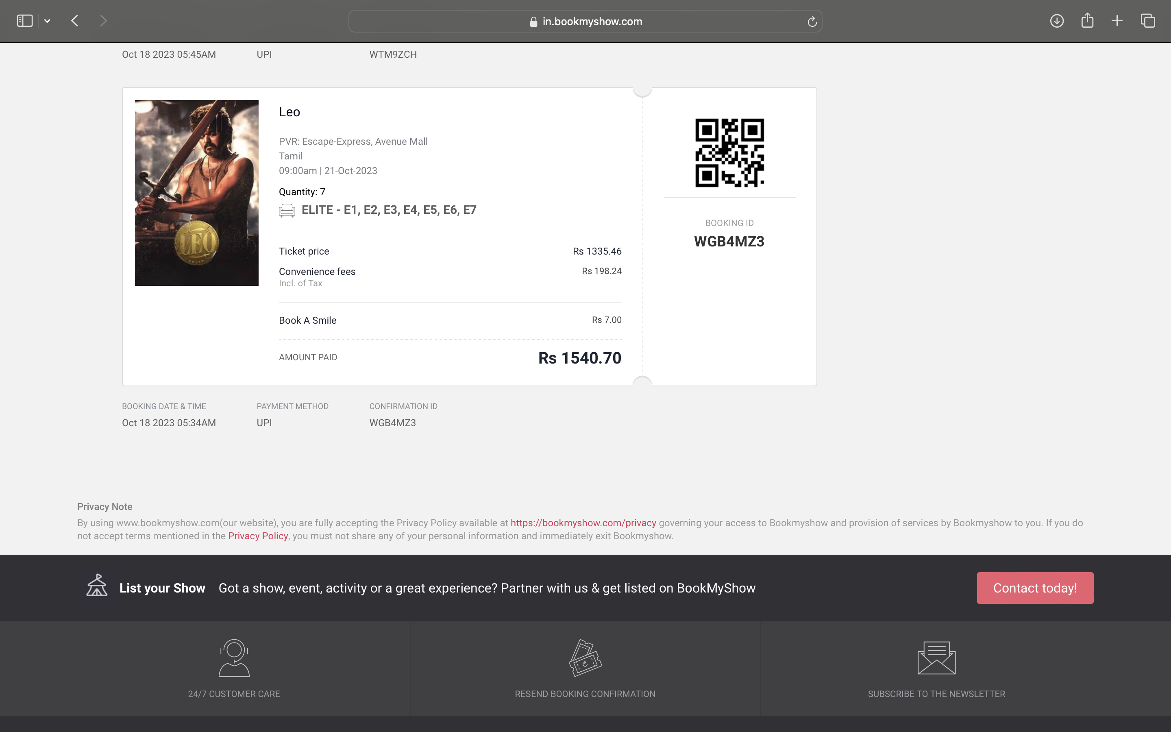
CONCLUSION
In summary, data structures are fundamental to the core functionality and performance of the BookMyShow app, facilitating efficient data management, search, scheduling, and user interactions. The choice of data structures depends on the specific requirements of each feature within the application.
These are some of the core data structure concepts that the BookMyShow app utilizes to provide efficient and responsive services to its users. The specific choice of data structures depends on the requirements of individual features and functions within the app.

